Slide 1
DIABETES DETECTION SYSTEM
GROUP NO:
GROUP MEMBERS:
HARSHITHA.V(1AT19IS038)
INCHARA.A(1AT19IS043)

Slide 2
OUTLINE
ABSTRACT
INTRODUCTION
ARCHITECTURE DIAGRAM
METHODOLOGY
SCREENSHOTS
DEMONSTRATION
CONCLUSION
REFERENCES

Slide 3
1. ABSTRACT
The “DIABETES DETECTION SYSTEM” has been developed to override the problems prevailing in the practicing manual system. The software is supported to eliminate and in some cases reduce the hardships faced by existing system. Moreover, this system is designed for the particular need of the company to carryout operation in the smooth and effective manner.
The system will ultimately allow you to manage resources, basically the project describes how to manage for good performance and better record organization for the admin.

Slide 4
2. INTRODUCTION
If you are facing with any kind of disease or infection and knowing about these disease on time will help you to get cure and take precautions on time. This process will also help to get over from these suffering in few days or in months. Among several diseases and sufferings, many peoples are suffering from diabetes. With this computer based diabetes detection software, user will able to do their self-checkup without taking help of a doctor. This system will keep records of particular patient or of any person and by using their general data collected during analysis process it will able to tell you, whether you are suffering from diabetes or not. Apart from these, based on your collected data, it will also provide suggestion and general precautions which is to be taken by you in order to improve your health. This system having the ability to detect diabetes and categories as per the data which has been collected during questions answer section. Its user friendly graphical mode will make its user to use this system in interactive manner. You will have to just answer few questions and these questions has been divided into two section. Upon completion of these questions you will able to get your final result and your health status regarding diabetes. To keep records, you will required to ask your basic information and using these information, your final report will be prepared by keeping view of answer which has been provided by you. Number of options will be given in answer section and you have to select whatever suits you the best.

Slide 5
3. ARCHITECTURE DIAGRAM

Slide 6
System architecture is the conceptual model that defines the structure, behavior, and more views of a system. System architecture conveys the informational content of the elements comprising a system, the relationships among those elements, and the rules governing those relationships. The architectural components and set of relationships between these components that an architecture description may consist of hardware, software, documentation, facilities, manual procedures, or roles played by organizations or people.

Slide 7
4. METHODOLOGY
All your previous and new records will be saved using the concept of file and directory. Binary search operation will be performed while searching your record and you will also able to get your previous diagnosis report while using this system. This system will able to identify your sufferings related to diabetes and store into the file with your record id. Each patient will have particular record id and while searching, patient can diffracted between their details and others by selecting their date of birth and address details.

Slide 8
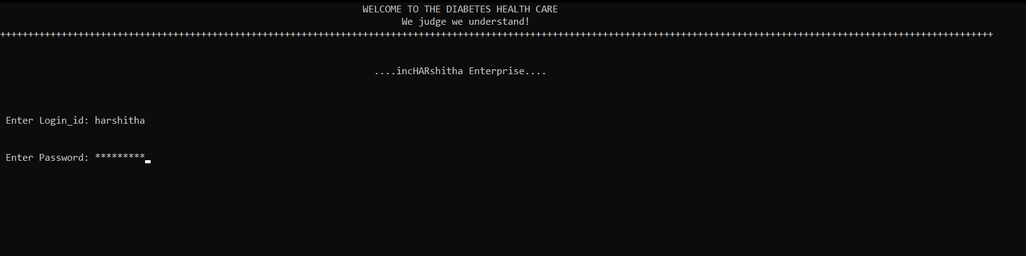
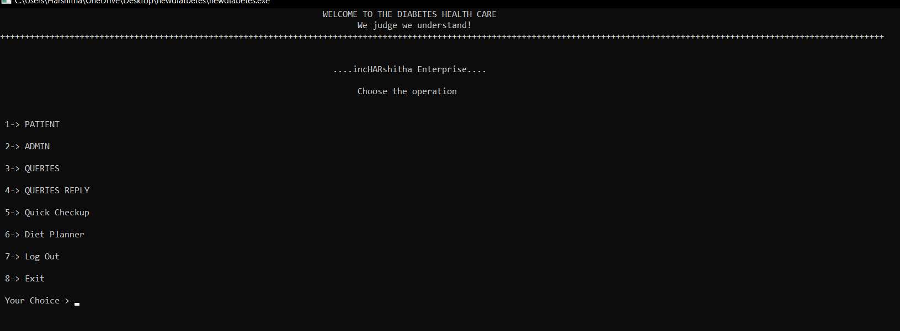
5. FIRST LOOK OF THE PROJECT

Slide 9
6. DEMONSTRATION

Slide 10
7. CONCLUSION
As per the existing system, users have to invest money before knowing their diagnosis report. They have to visit diagnostic center, consult their doctor and wait for a day to get their result. If someone have only doubt and want to have a checkup, then it will have their wastage of money and time for them. Each time you have to provide your basic information and go through the same diagnosis process to get your diagnosis result which can be dangerous in some serious condition. Patients should go through the checkup process immediately before the diagnosis process, if such condition arises. So keeping customer records and searching their records manually sometimes not possible and sometime it’s a time taking process.

Slide 11
8. REFERENCES
[1] M. J. Folk and B. Zoellick, File Structures, Third Edition, Pearson Education, Inc, 1998.
[2] f T. E. Anderson, M. D. Dahlin, J. M. Neefe, D. A. Patterson, D. S. Roselli, and R. Y. Wang. “Serverless Network File Systems”, Proceedings of the 15th ACM Symposium on Operating Systems Principles, Dec 1995.
[3] S. D. Viglas. Distributed File Structures in a Peer-to-Peer Environment. Technical report,
University of Edinburgh, School of Informatics, 2006-2007

Slide 12
THANK YOU!

